Slide 1

Exploiting Latency and Error Tolerance of GPGPU Applications for an Energy-efficient DRAM
Haonan Wang, Adwait Jog
College of William & Mary

Slide 2
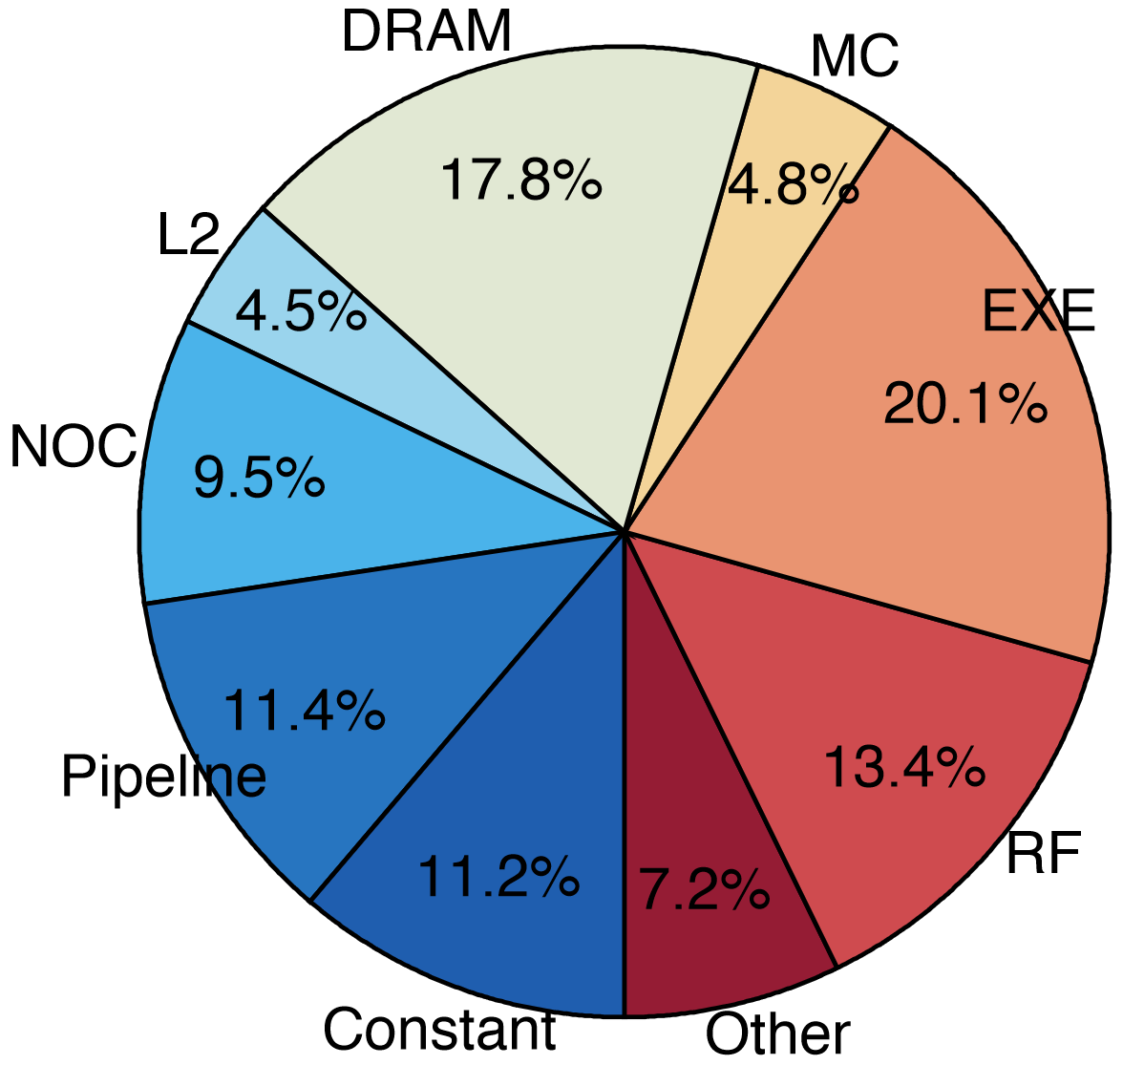
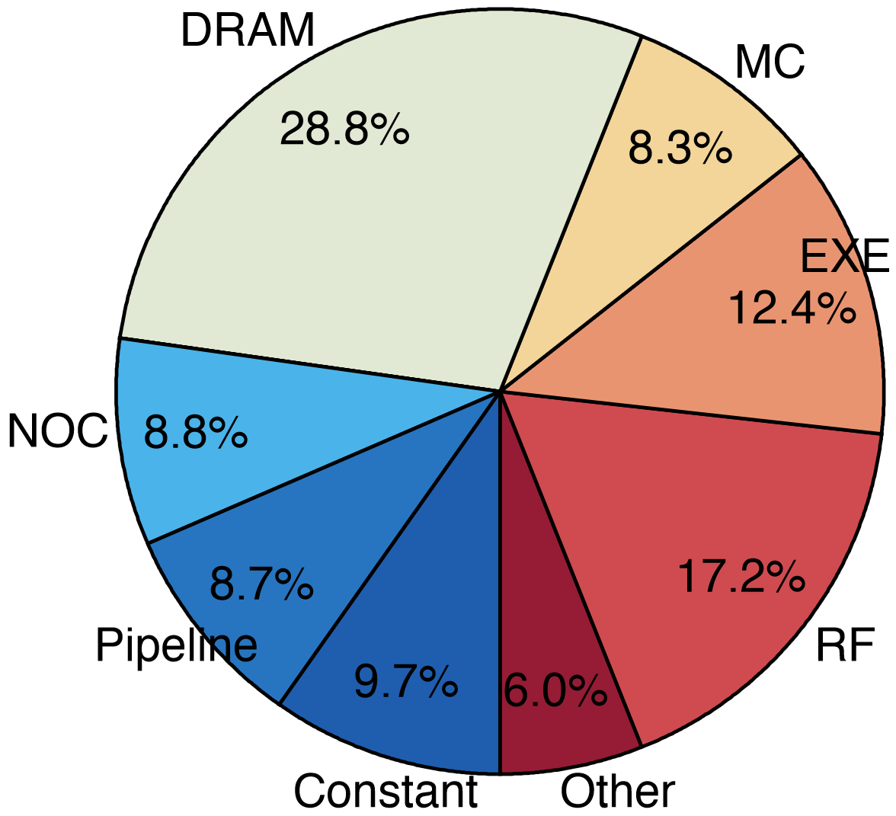
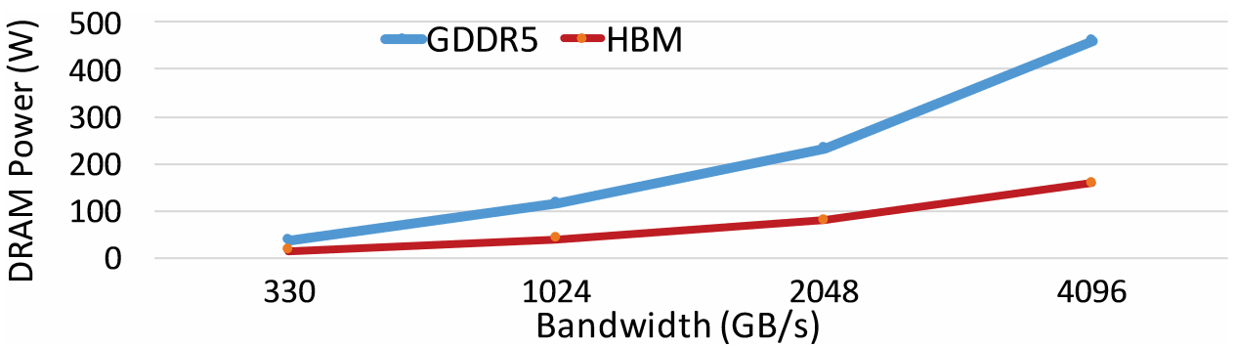
The Problem of Memory System Energy
Memory system consumes a large of fraction of GPU total energy.
Memory power consumption is an impediment for further scaling.
Non-linear increase!
GTX480
Quadro 5600
1. J. Leng, et al. “GPUWattch: Enabling Energy Optimizations in GPGPUs.” ISCA2013.
2. O'Connor, Mike, et al. “Fine-grained DRAM: energy-efficient DRAM for extreme bandwidth systems.” MICRO2017
Notes:
Nowadays, memory energy consumption has become one of the biggest problems for GPUs.
The power supply is limited. However, the power increases non-linearly with increased bandwidth.
ICS

Slide 3
Source of Memory Energy Consumption
Memory Array
Row Buffer Locality (RBL) =
# Row Buffer Data Reuse per Row Activation
Row open:
Activation
Row close:
Restore & Precharge
Row Buffer
Expensive
Higher RBL ⬄ Better Energy Efficiency
Notes:
Stress more on rbl
Expensive -> reduce -> increase RBL -> RBL definition

Slide 4
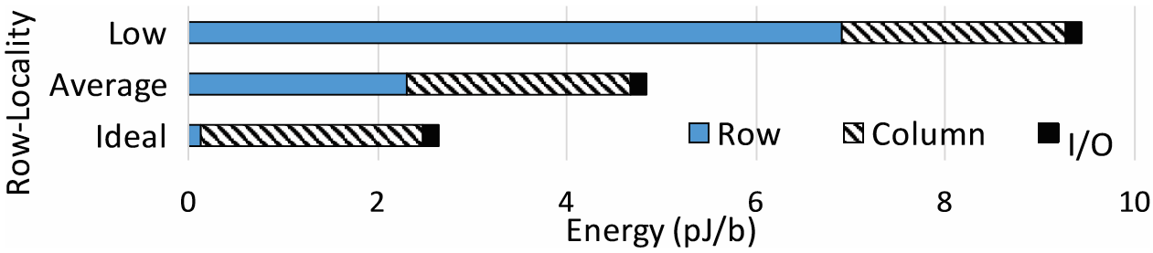
Row Energy Dominates Memory Energy
HBM energy proportions for different Row-Locality:
Reducing row energy is the key for reducing the overall memory energy consumption.
1. O'Connor, Mike, et al. "Fine-grained DRAM: energy-efficient DRAM for extreme bandwidth systems." MICRO2017
Notes:
As shown by prior works,

Slide 5
Goal & Solution
Goal: Improving GPU memory energy efficiency by enhancing the Row Buffer Locality of GPU memory
Solution: Designing novel memory scheduling techniques (Lazy Memory Scheduling)
Delayed Memory Scheduling (DMS): utilizes the delay tolerance feature of GPGPU applications.
Approximate Memory Scheduling (AMS): utilizes the error tolerance feature and non-uniform RBL distributions of GPGPU applications.
Notes:
Use more colors

Slide 6
Outline
Background & Motivation
Design of AMS & DMS
Evaluation
Conclusion

Slide 7
Memory Row Operations
Access Address: Row Operation:
Columns
(Row 0, Column 0)
Activation
RBL=2
(Row 0, Column 1)
No operation
RBL=1
(Row 1, Column 0)
Restore, Precharge, Activation
Row address 0
Row address 1
Row decoder
R1
R0
R0
Rows
Row Buffer
CONFLICT !
Row 1
HIT
Row 0
Empty
Column address 0
Column mux
Similar behaviors exist in newer memory technologies like HBM and HBM2.
Column address 0
Column address 1
Data
1. Credit: Onur Mutlu.
Notes:
Reduce accesses
Stress R0 has row of 0

Slide 8
RBL & Memory Scheduling Schemes in GPUs
Visible to the memory scheduler
In-order scheduling
(FIFO):
Activation Counter:
R1: Activation = 1
R5: Activation = 2
R1: Activation = 3
R5: Activation = 4
R5: Activation = 4
Avg RBL = 5 / 4 = 1.25
future
requests
requests currently
in the pending queue
oldest
request
Same
activation
Request Stream
……
……
R4
R3
R2
R5
R5
R1
R5
R1
Out-of-order scheduling
(FR-FCFS):
Activation Counter:
R1: Activation = 1
R1: Activation = 1
R5: Activation = 2
R5: Activation = 2
R5: Activation = 2
Avg RBL = 5 / 2 = 2.5
future
requests
requests currently
in the pending queue
Same
activation
oldest
request
Same
activation
Request Stream
……
……
R4
R3
R2
R5
R5
R1
R5
R1
Notes:
introducing what is r1
Note that only requests in the pending queue are visible to the memory controller, and the pending queue has a capacity limit.

Slide 9
How can we further improve the RBL?

Slide 10

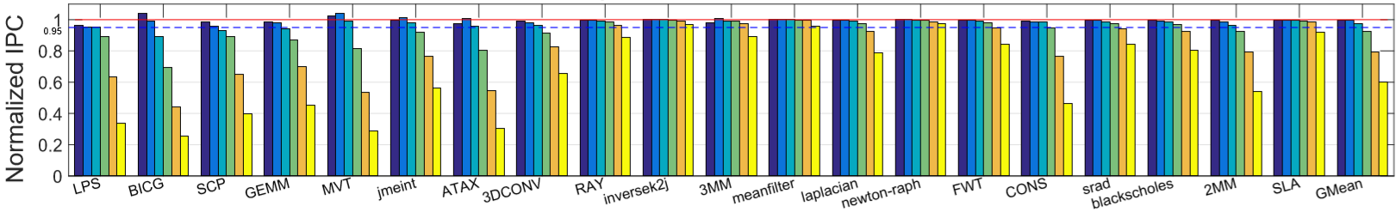
Observation I: Latency Tolerance
Many GPGPU applications are latency-tolerant and have different delay-tolerance levels.
Numbers in the brackets are the applied delay
95% Threshold
The average IPC of all applications does not drop below 95% with 256 cycles delay.
The IPC for each applications does not drop below 95% with 128 cycles delay.

Slide 11
Motivation: Delayed Memory Scheduling (DMS)
Visible to the memory scheduler
No delay:
future
requests
requests currently
in the pending queue
For R1 through R4:
Activations = 8
Requests = 8
Avg Locality = 8/8 = 1
request
X cycles away
oldest
request
Request Stream
……
R4
R3
R2
……
R1
R1
R4
R3
R2
Visible to the memory scheduler
With delay:
future
requests
requests currently
in the pending queue
For R1 through R4:
Activations = 4
Requests = 8
Avg Locality = 8/4 = 2
request stalled
for X cycles
Request Stream
……
R4
R3
R2
……
R1
R1
R4
R3
R2
Notes:
intuition

Slide 12
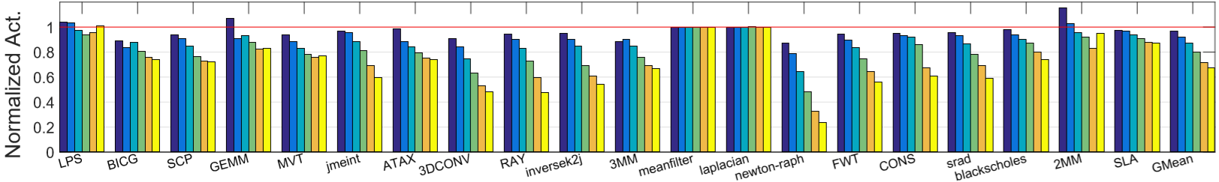
Motivation: Delayed Memory Scheduling (DMS)
The average RBL of many GPGPU applications can be improved via adding delay:
Numbers in the brackets are the applied delay
Normalized
number of row activations
(lower the better)
More Delay → More Visibility → Less Activations
Notes:
Based on the previous intuition,

Slide 13
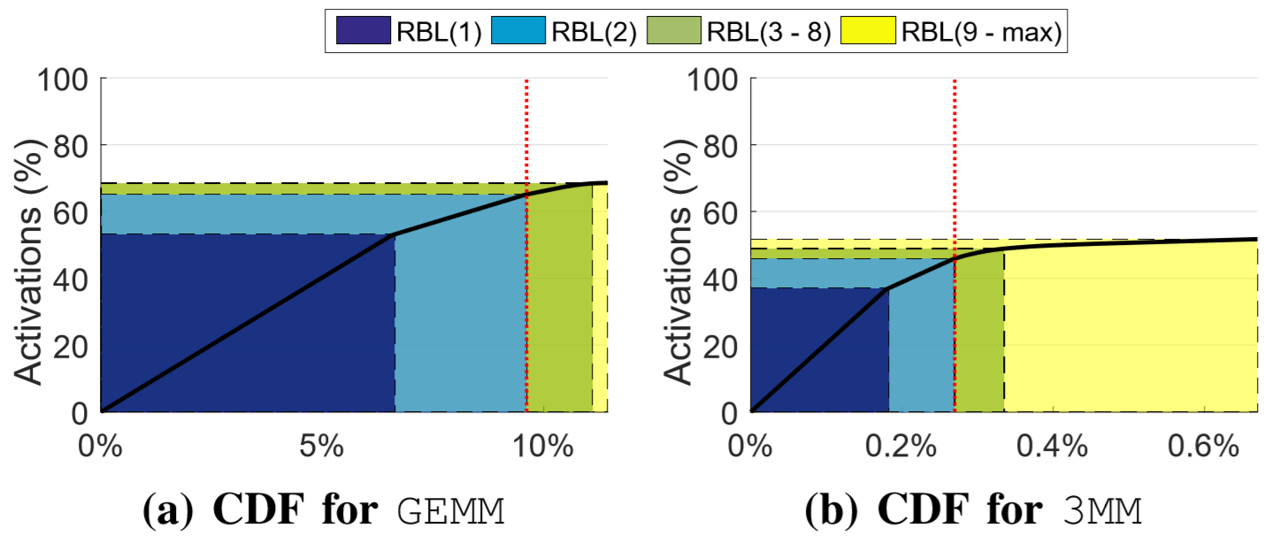
Observation II: Non-uniform RBL distribution
Many GPGPU applications have non-uniform RBL distributions.
Correlation of RBL and their corresponding read requests:
Number in the brackets is the RBL of an activation
Proportion of Activations
proportion of requests
Small proportions of requests can be approximated to reduce large proportions of activations
-- Approximate Memory Scheduling (AMS)
Notes:
Correlation of RBL and their corresponding requests (read requests only).

Slide 14
Approximate Memory Scheduling (AMS)
Given a coverage budget, AMS drops requests with low RBLs (user specified).
For R1 through R3:
If no request is dropped from the pending queue:
Activations = 3
Requests = 5
Avg Locality = 5/3 = 1.67
Visible to the memory scheduler
future
requests
requests currently
In the pending queue
oldest
request
Request Stream
……
R3
R1
R1
R2
R1
If one request with RBL<2 is dropped & approximated:
Activations = 2
Requests = 4
Avg Locality = 4/2 = 2
Notes:
the oldest requests will be dropped for requests with the same RBL.

Slide 15
Cooperation: DMS Can Help AMS
Visible to the memory scheduler
For R1 through R5:
If the oldest is dropped:
Activations = 5
Requests = 8
Avg Locality = 8/5 = 1.6
future
requests
requests currently
In the pending queue
AMS & No DMS:
request
4 cycles away
oldest
request
Request Stream
……
R4
R3
R2
R1
R5
R4
R3
R2
R1
Visible to the memory scheduler
For R1 through R5:
If the request to
R5 is dropped:
Activations = 4
Requests = 8
Avg Locality = 8/4 = 2
future
requests
requests currently
In the pending queue
AMS & DMS:
request stalled
for 4 cycles
Request Stream
……
R4
R3
R2
R1
R5
R4
R3
R2
R1
DMS can increase the visibility of requests for AMS.
Notes:
Visibility is improved.

Slide 16

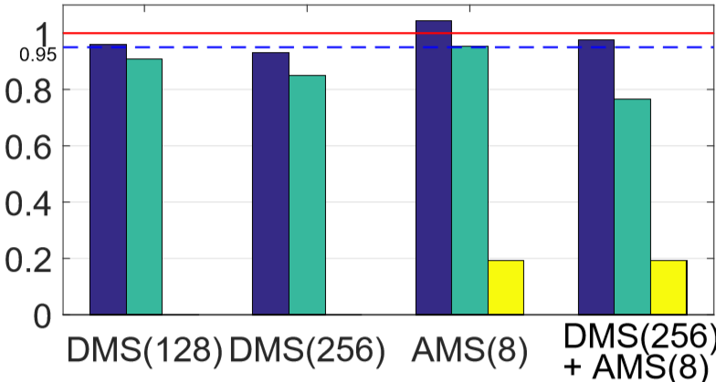
Cooperation: AMS Can Help DMS
Metric names
Application LPS
AMS is able to increase the maximum delay used in DMS.

Slide 17
Outline
Background & Motivation
Design of AMS & DMS
Evaluation
Conclusion

Slide 18
Design Overview
Interconnect
R2
R3
R1
L2 Cache
Value
Predictor
Dropped
Reads
L2 Misses
Normal
Reads
Pending Queue
Memory
Controller
……
Main Memory
Request Metadata
DMS Unit
…
Timestamp
Bank
Address
Cell Arrays
Read/Write
Timestamp
AMS Unit
Address &
Read/Write
Row Buffer
Issued
Requests
…

Slide 19
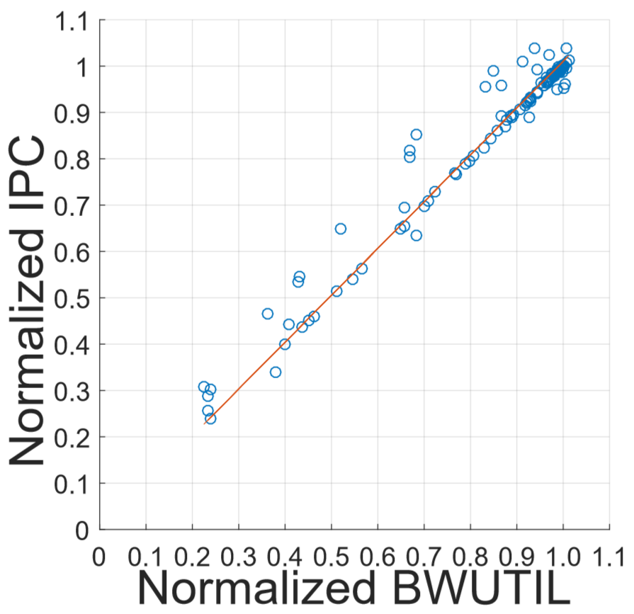
DMS Design: Static-DMS & Dynamic-DMS
Static-DMS: Using a static Delay-threshold
Does not work well for all applications
Not fine-grained
Dyn-DMS: Adjusting the Delay-threshold based on the current bandwidth utilization (BWUTIL)
Adjust Delay-threshold according to the Delay-tolerance of the application
Fine-grained tuning based on BWUTIL profiling
Correlation of BWUTIL & IPC:

Slide 20

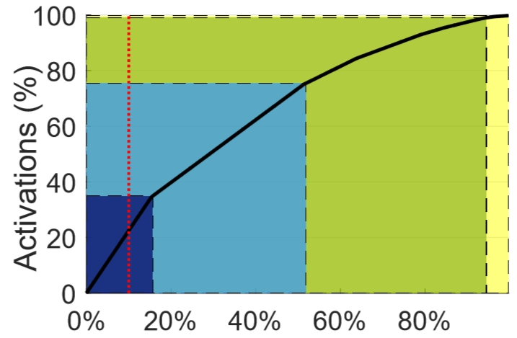
AMS Design: Static-AMS
Under a coverage budget, activations with RBLs <= static threshold will be dropped:
Does not work well for all applications
Application SCP:
Number in the bracket is the RBL for an Activation
10% coverage budget
Static RBL-threshold = 8
Proportion of Activations
proportion of requests

Slide 21
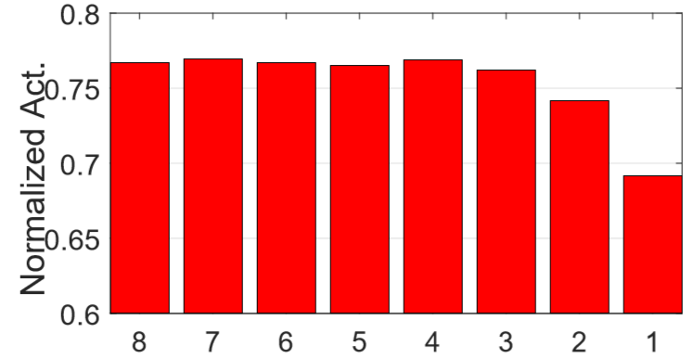
AMS Design: Dynamic-AMS
Reducing the RBL-threshold based on the current prediction coverage:
Adjust RBL-threshold according to the RBL distribution of the application
Application SCP:
Normalized number of row activations
(lower the better)
RBL-threshold
(to drop request)
With same coverage: Lower RBL-threshold → Less Activations
Notes:
Therefore, the dynamic ams tries to reduce the RBL threshold as much as possible whiling maintaining the prediction coverage.

Slide 22


Value Prediction Unit
Our simple approach --- uses cache lines with closest addresses for approximation
Baseline Output
Approximate Output
Approximate Output
Prior works can further improve the prediction accuracy:
Load Value Approximation (MICRO’14), Doppelganger (MICRO’15),
RFVP (TACO’16), Bunker Cache (MICRO’16)
Notes:
As these works shows good prediction accuracy meanwhile significantly improving the performance.
3 are from micro and 1 is from taco.

Slide 23
Outline
Background & Motivation
Design of AMS & DMS
Evaluation
Conclusion

Slide 24
Evaluation Methodology
Evaluated using GPGPU-Sim -- a cycle accurate GPGPU simulator
Baseline Configuration
30 SMs, 32-SIMT Lanes, 32 Threads/Warp, 48 Warps/SM
16KB L1 (4-way, 128B Cache Block) + 32KB Shared Memory per SM
256KB L2 (8-way, 128B Cache Block) per Memory Partition
6 GDDR5 Memory Partitions, 16 Banks/Partition, FR-FCFS, Open-row policy
1 Crossbar/Direction
Workloads -- 20 Applications
From CUDA SDK, Polybench and Axbench
Divided into different groups based on their characteristics
Contains both Error-tolerant and Non-error-tolerant applications

Slide 25

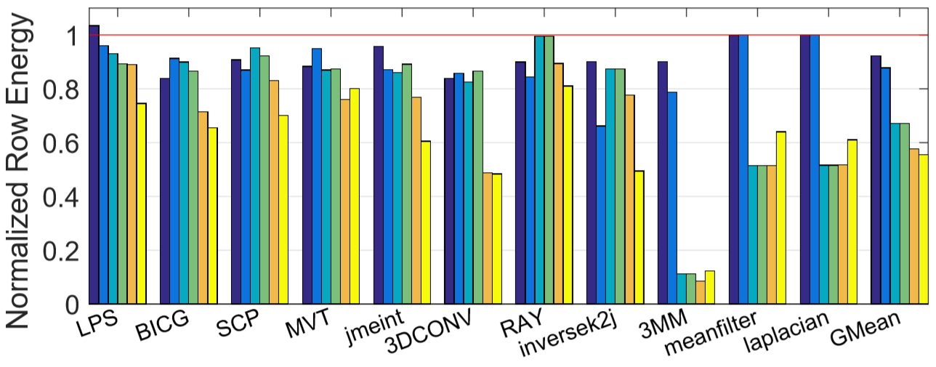
Error Tolerant Applications: Row Energy
Individual schemes:
Combined schemes:
Static-DMS: 8%
Dyn-DMS: 12%
Static-AMS: 33%
Dyn-AMS: 33%
Applications with 10% coverage:
Static-AMS: 7%
Dyn-AMS: 11%
Static-DMS & Static-AMS: 42%
Dyn-DMS & Dyn-AMS: 44%

Slide 26
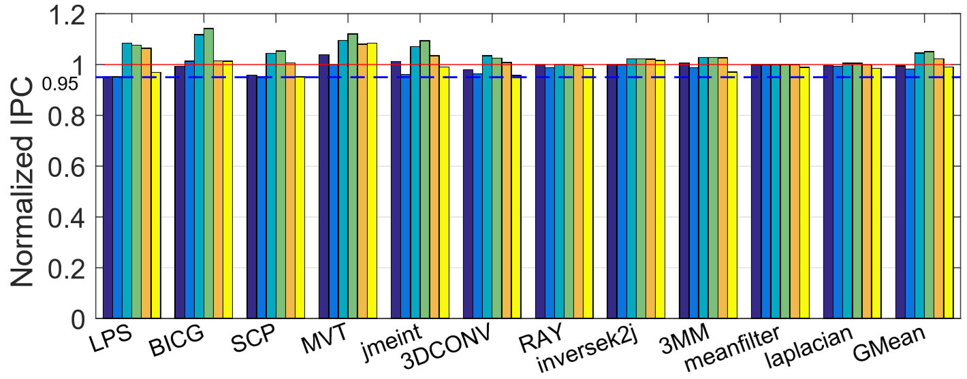
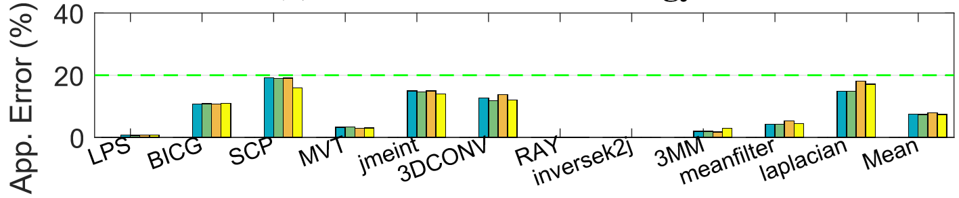
Error-tolerant Applications: IPC & Error
Performance:
95% Threshold
Application Error:
20% Threshold

Slide 27
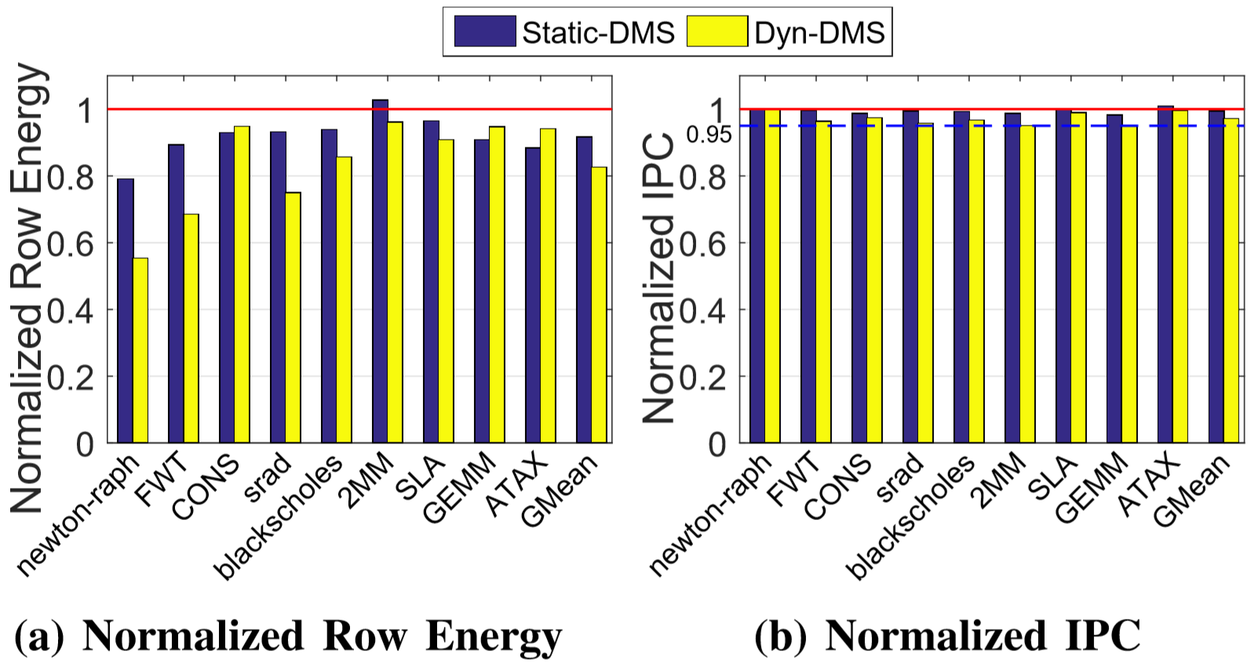
Non-error-tolerant Applications: Row Energy & IPC
Non-error-tolerant Applications can run in Delay-only mode:
95% Threshold

Slide 28
Conclusions
Problem: GPU memory energy consumption
Goal: Improving the Row Buffer Locality
Contributions:
Lazy Memory Scheduler
Delayed Memory Scheduling (DMS): delaying the scheduling of memory requests can significantly improve the overall row buffer locality
Approximate Memory Scheduling (AMS): approximating a small fraction of memory requests can reduce a large fraction of row activations (i.e., there is non-uniform reuse of row buffers)
Lazy Memory Scheduler reduces row energy by 44% with less than 1% IPC loss across a variety of GPGPU applications

Slide 29
Thank You! Questions?
We acknowledge the support of the National Science Foundation (NSF) grants (#1657336, #1717532 and #1750667)

Slide 30
Backup Slides

Slide 31
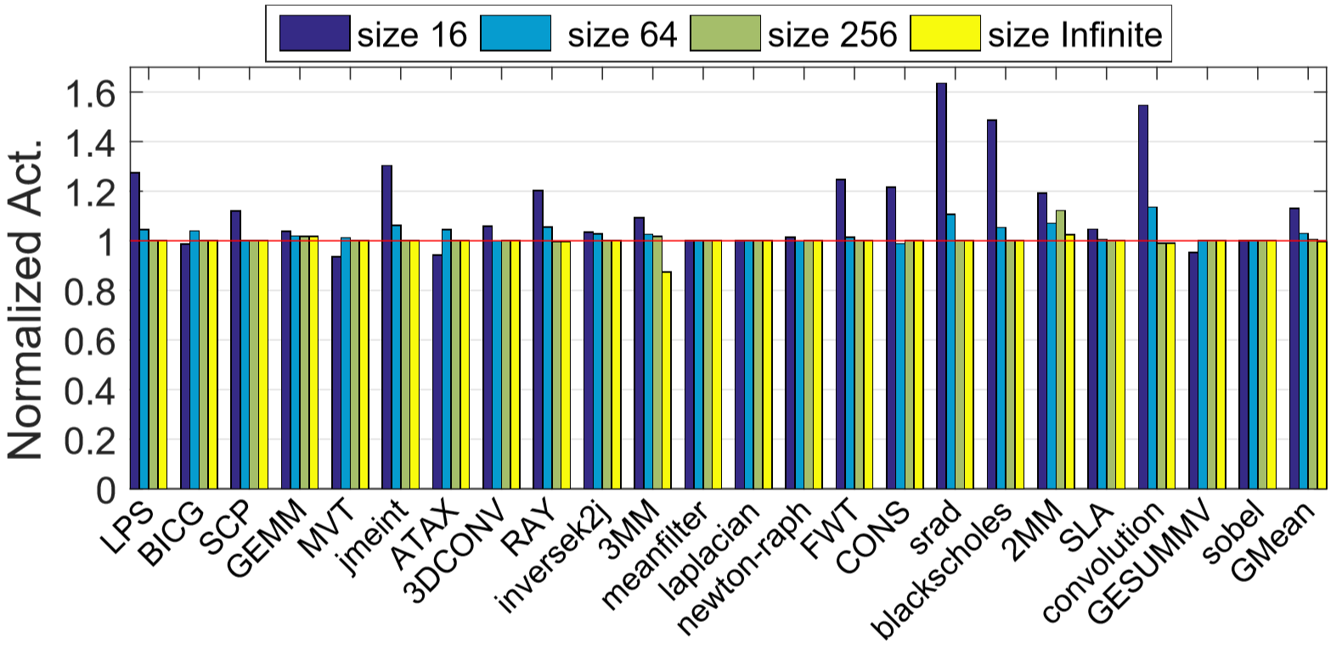
Effect of Pending Queue Size
The capacity of the pending queue can limit the re-ordering ability of FR-FCFS.
Normalized Row Activations for different pending queue sizes (baseline is 128):
Pending queue size
Number of Activations stops reducing after size 128 (red line)
The Row Activation Reduction is limited for many applications even with large pending queue size.

Slide 32
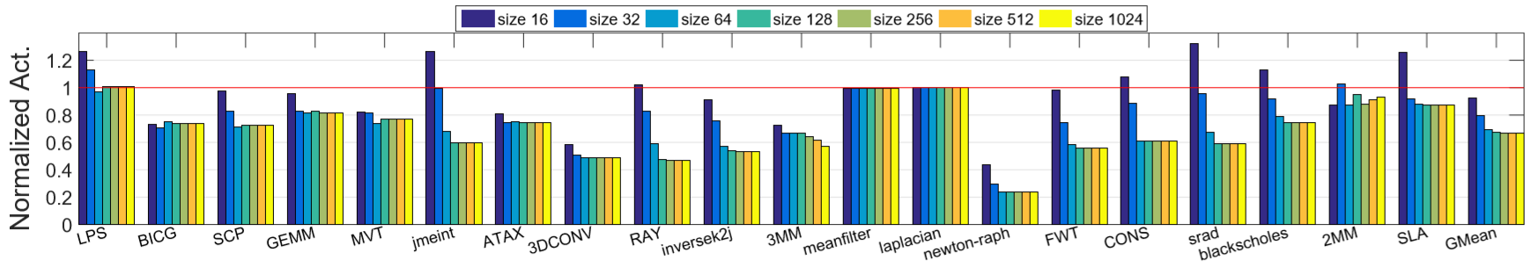
Effect of Pending Queue Size Under Delay
Effect of pending queue size with maximum delay (2048 cycles):
Pending queue size
For almost all applications, queue size 128 is sufficient even with the maximum delay of DMS.

